Slide 1
Build a Data Story
By MadjiteyY

Slide 2
Executive Summary
Introducing the Problem Statement which is:
What qualities or activities influenced the top 100 movies of all time defined by revenue?
What I noted in correlation with the problem being solved for are:
Budget amount
Vote count and
Movie popularity
Both Budget and Vote Count influenced the top 100 movies in terms of revenue. Although a weak relationship was visualized, a positive relationship exists between budget, vote count and revenue. Thus the higher the budget or vote count, the likelihood that higher revenues will be realized.
Recommendation:
A way to identify movies that would generate higher revenues is to:
look at the budget amount of the movie. Higher budget amount drives higher revenues.
Notes:
Speaker notes: 1) Introduce the problem statement. 2) Why is it important?
solving a problem that matters to the executive team of Spectacular Studios, one problem I would assume for the executive team is they trying to source top revenue movies. And the best way to help them identify those top revenue movies is where the recommendation is in line with the problem statement.

Slide 3
Overview of Analysis
The Problem Statement is to determine;
What qualities or activities influenced the top 100 movies of all time defined by revenue?
Analysis was then focused on the following:
Relationship between budget and revenue: If budget drives revenue
If vote count drives revenue
Relationship between popularity and revenue: if popularity drives revenue
Notes:
Speaker notes: 1) Restate the problem statement. 2) Break out the issue tree I have built up with the data-set in threefold and address them. So basically align the group that this is the problem statement and this is what I did to solve the problem statement. That is saying that the top 3 features that relate or correlate the most to revenue are budget, vote count and popularity.

Slide 4
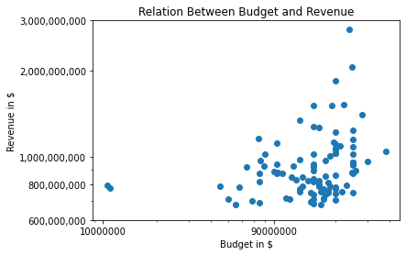
Budget: Revenue increases with high budget for movies
The correlation between budget and revenue is 0.315
Notes:
Speaker notes: The actual analysis tied to the problem statement are in three fold. Talk about the first of three elements. The hypothesis was, is the budget of a movie actually related to its revenue? Re-emphasize the fact that looking at the correlation, revenue is positively linked to budget.

Slide 5
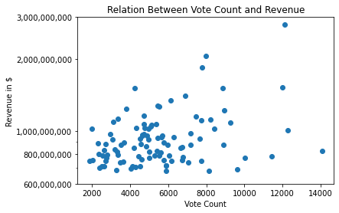
Vote Count: A positive relationship exists between vote count and Revenue
Correlation = 0.3768
Notes:
Speaker notes: vote count provides an additional opportunity besides budget for someone that is identifying top revenue movies as it is the most correlated with revenue.

Slide 6
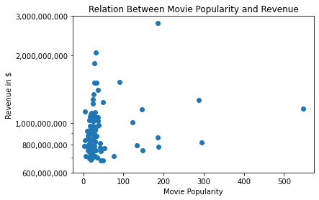
Popularity: Popularity of a movie does not necessarily influence its revenue.
Correlation = 0.209
Notes:
Speaker notes: popularity is the least correlated to revenue. there is no apparent link here.

Slide 7
Limitations and Biases (1 / 3)
Four different limitations and biases that might actually affect my recommendations have been categorised under:
Data collection
Selection bias that affects vote counts and popularity can be raised here as I am not sure how the data for both features was collected or calculated.
For instance, not all who have seen the movies in my top 100 voted and some might have voted based on their beliefs instead of considering an objective perspective.
Notes:
Speaker notes: This bias is really important and critical to my analysis as I am depending on vote count as a part of my recommendation.

Slide 8
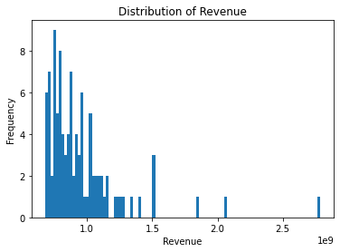
Limitations and Biases (2 / 3)
2. Data Processing
The distribution of revenue is right-skewed with outliers
Revenue is heavily right-skewed with a significant number of outliers. However, I decided to keep them as they make up the top 100 of my analysis. The outlier is calculated as $1,406,734,550 or 1.4 1e9. Therefore, any amount greater than this figure is considered an outlier.
Notes:
Speaker notes: Revenue is the most important bias as I am focusing on revenue as the outcome variable. Understanding the biases here is critical to this analysis. Revenue in general is inherently biased. Some movies may bring what can be described as exaggerated figures and this is why I want to know what characterises such odd occurrences.

Slide 9
Limitations and Biases (3 / 3)
3. Data Insights
Confounding variables such as actors in a movie that could actually influence vote count as people would vote for their favorite actors in a movie instead of the movie in question.
Confirmation Bias as I considered a few selected features to analyze the problem at hand instead of considering the data as a whole.
Notes:
Speaker notes: Talk about reviewer objectivity here. hypothesis was based on my beliefs rather than considering an objective perspective.

Slide 10
Next Steps
Sourcing movies with high revenues by budget and vote count as budget and vote count are known to be correlated with revenue.
Data concerning actors in a movie can be collected and tested. As people love to watch their favorite actors.
Notes:
Speaker notes: push the biases here.

Slide 11
Appendix
Issue Tree
What qualities or activities influenced the top 100 movies of all time defined by revenue?
Vote count? Does a higher vote count mean more revenue as it will influence people to see the movie?
Popularity? Does a popular movie mean bigger audience hence higher revenues?
Budget? Does a higher budget mean a good movie hence more audience leading to higher revenues?
Notes:
Speaker notes: demonstrate what went into the issue tree.

